Slide 1

Credit Card Fraud Detection
Artificial Intelligence Project
Group Number: 11
Presented by: Manal (2253), Saba Zulfiqar (2251), Ifra (2235)

Slide 2
Project Overview
Objective
Goal
Problem
Detect fraudulent credit card transactions using classification models.
Improve financial security by identifying fraud patterns in transaction data.
Data imbalance makes it difficult to detect rare fraud cases among normal transactions.

Slide 3



Methodology
Dataset
Tools
Models Used
Credit Card Fraud Dataset from Kaggle.
Python, Pandas, Scikit-learn, and Matplotlib.
Logistic Regression and Random Forest Classifier.

Slide 4
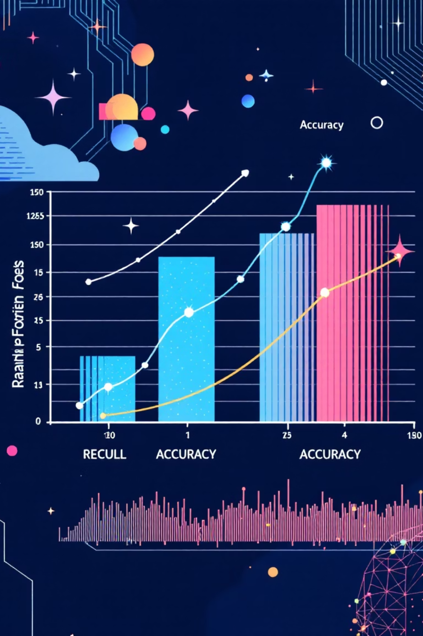
Model Results
Logistic Regression Performance:
Random Forest Performance:
Recall: 0.00 (Failed to identify fraud cases).
Recall: 0.75 (Caught 75% of fraud cases).
Accuracy: 98%.
Accuracy: 97%.

Slide 5


Conclusion
Final Model
Key Insight
Logistic Regression was selected for its superior fraud detection capability.
In fraud detection, high Recall is prioritized over overall Accuracy to ensure fraudulent activities are not missed.

Slide 6

Project Deliverables
GitHub Repository: https://github.com/iifraaltaf-ctrl/Fraud-Detection-Group-11
Contents: Source Code (.ipynb), Project Documentation (PDF), and Result Screenshots.

